Slide 1
Binary Data
Unit 2.01 Binary Data

Slide 2
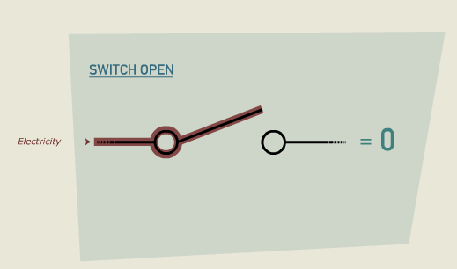
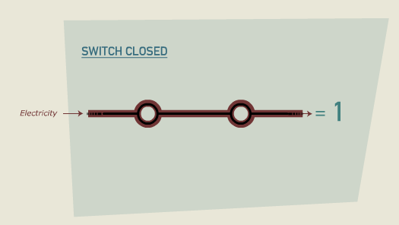
Binary
Early Binary Switch Computers
Early computers stored data using electronic switches that could be either in the off (0) or on (1) position. When a switch stores a value, whether it is 0 or 1, it is called a bit.

Slide 3
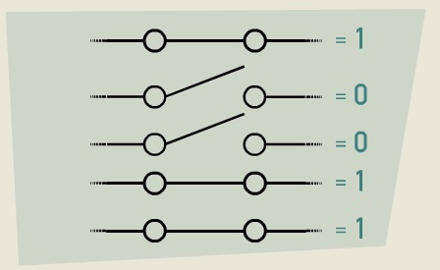
Binary
Multiple Binary Switches
Modern day computers do not use mechanical switches per se, but rather tiny transistors. Millions of these transistors can fit in a square centimeter of space.

Slide 4
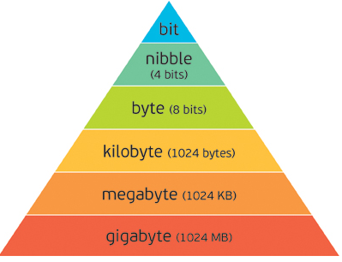
Binary
Bit vs Byte
In computing bits are often segmented into blocks of 8.
8 bits = 1 byte
A bit is generally identified with
a lower case b
A byte is identified with
an upper case B
So Kb != KB
A Kilobit is about 1000 bits
A KiloByte is about 8 X 1000 bit

Slide 5
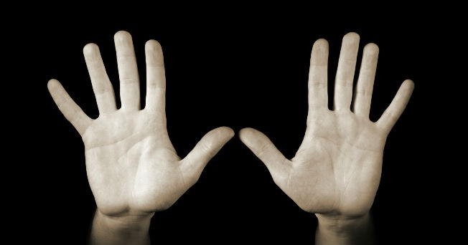
Binary
How do you think a computer can only know 2 pieces of information but still store so much data?
How many fingers am I holding up?

Slide 6
Binary
How many different ways can I write that number?
10
IIIII IIIII
X
TEN
2 * 5
20 / 2

Slide 7
Binary
Consider this:
When we write the number TEN we are using letters.
How many letters are there in the english alphabet?
How many words can
we write with those 26
letters?

Slide 8
Binary
Consider this:
What about when we write it as an integer 10
How many numerals
are there?

Slide 9
Binary
0
1
2
3
4
5
6
7
8
9
Consider this:
What about when we write
it as an integer 10
How many numerals
are there?

Slide 10
Binary
0
1
2
3
4
5
6
7
8
9
Consider this:
How many numbers can we
write with these 10 numerals?
Why do we have 10 numerals?
Could it be because that is the
number of fingers we have on
our hands?

Slide 11
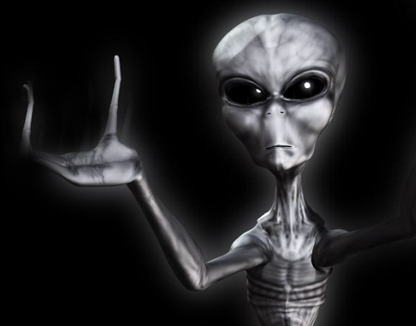
Binary
0
1
Consider this:
What if we were aliens and
only had 2 fingers?
How many numbers
could we create with
only 2 numerals?

Slide 12
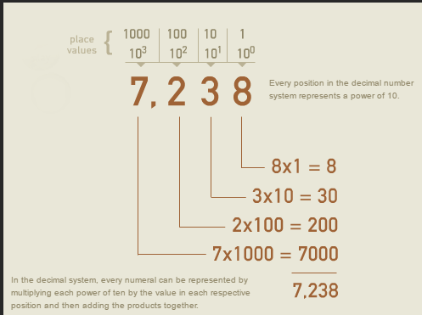
Binary
With 10 numerals we move over a column once we reach the end of the numeral sequence 0 - 9

Slide 13
Binary
0
1
Could we do something similar with only
2 numerals?
1 = 01
2 = 10
3 = 11
4 = 100

Slide 14
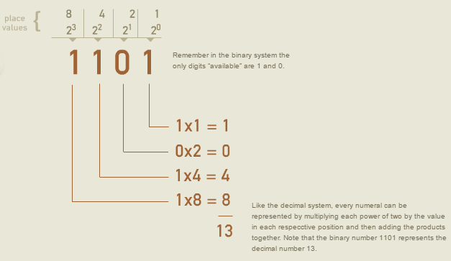
Binary
The binary system is similar to the decimal system because the value of the numbers also depends on their position. However, the binary system utilizes only two digits (1 and 0) instead of 10 digits

Slide 15

Binary
In Other Words….
Brief Video
https://www.youtube.com/watch?v=Xpk67YzOn5w

Slide 16
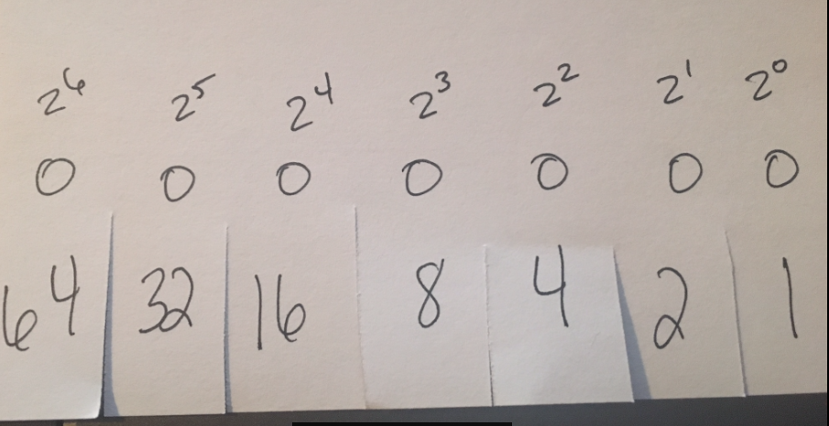
Binary
Let’s try counting in Binary.
You all have a 3 x 5 index card that has been modified as a sort of Binary Calculator

Slide 17
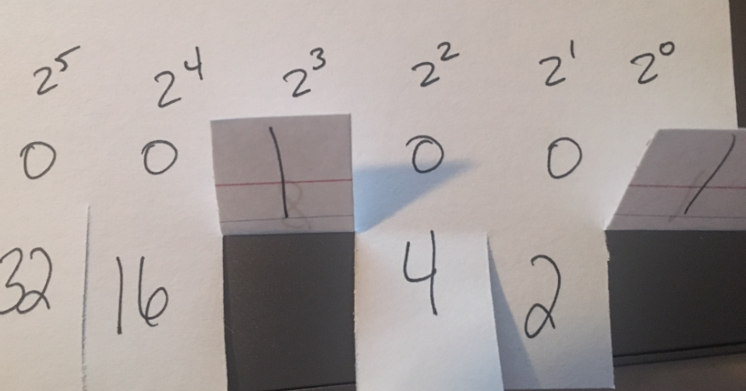
Binary
Let’s try counting in Binary.
When I call out a number I want you to fold up the flaps of one or more numbers that would equal the number I called out. Then read off the
Binary number starting
With the first 1.
For example if I said 9
You would fold up
8 and 1 which would
Reveal that 9 = 1001

Slide 18
Binary
Let’s try counting in Binary.
0 zero 1 one 10 two 11 three 100 four 101 five 110 six 111 seven 1000 eight 1001 nine 1010 ten

Slide 19
Binary
So if all data in computers is stored, transmitted, and processed in binary how do we get letters out of numbers?
ASCII stands for American Standard Code for Information Interchange. Computers can only understand numbers, so an ASCII code is the numerical representation of a character such as 'a' or '@' or an action of some sort. ASCII was developed a long time ago and now the non-printing characters are rarely used for their original purpose. Below is the ASCII character table and this includes descriptions of the first 32 non-printing characters. ASCII was actually designed for use with teletypes and so the descriptions are somewhat obscure

Slide 20
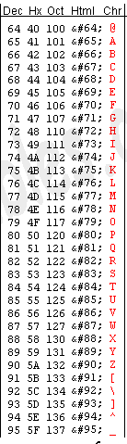
Binary
A = 65
B = 66
C = 67
D = 68
E = 69
F = 70
G = 71
H = 72
I = 73
J = 74
K = 75
L = 76
M = 77
N = 78
O = 79
P = 80
Q = 81
R = 82
S = 83
T = 84
U = 85
V = 86
W = 87
X = 88
Y = 89
Z = 90
ASCII Letters:
H = 1001000
E = 1000101
L = 1001100
L = 1001100
O = 1001111

Slide 21
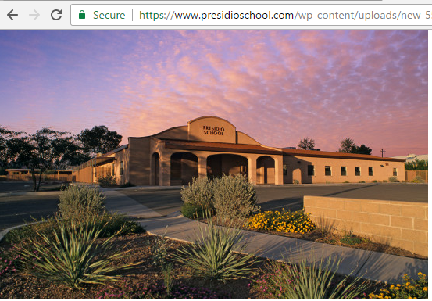
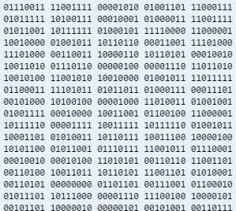
Binary

Slide 22

Binary
How might this image be represented in Binary

Slide 23
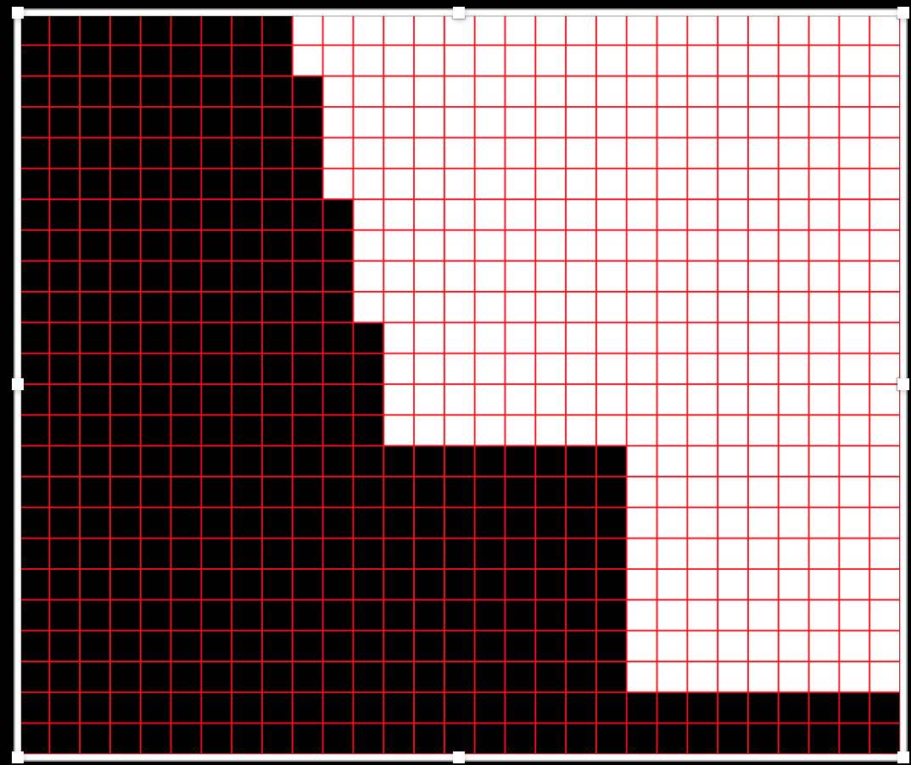
Binary
When we zoom in to look at the individual pixel we find that we could represent each block with a 1 for black or a 0 for white

